Slide 1


WELCOME TO CIMPOD 2017!

Slide 2

Discover New Methods, Answer Patient-Centered Questions

Slide 3

CIMPOD 2017
“Putting the Methods into Practice”
  2 Days
  11 Speakers
  18 Workshops
Workshop presentation and materials will be available at cimpod2017.org
For CIMPOD 2016, go to cimpod2016.org

Slide 4

Our Funder
Funded though a Patient-Centered Outcomes Research Institute (PCORI) Eugene Washington PCORI Engagement Award (865-MTPPI)

Slide 5






Our Sponsors

Slide 6
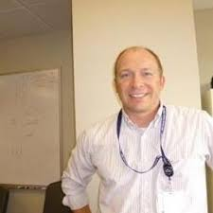
Acknowledgements
CIMPOD 2017 would like to thank NIDDK for its support in hosting this conference
Special thanks to
Kenneth J. Wilkins, NIDDK
  It’s not happening without you

Slide 7
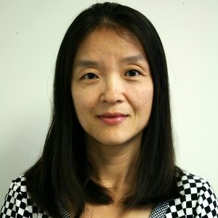
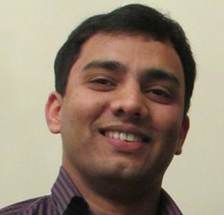
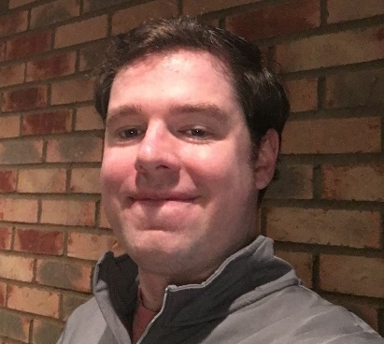
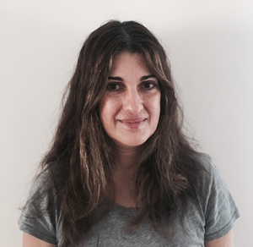
MTPPI CIMPOD Conference Team
We’re here to help
Yi
Onkar
Nick
Mae

Slide 8
Speakers

Slide 9
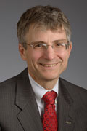
Gregory Germino,
MD
Deputy Director of the National Institute of Diabetes and Digestive and Kidney Diseases (NIDDK) at the National Institutes of Health (NIH)
Prior to joining NIDDK, Dr. Germino was a full professor at the Johns Hopkins University where he directed the Johns Hopkins Polycystic Kidney Disease (PKD) Center
CIMPOD 2017: Welcoming remark

Slide 10
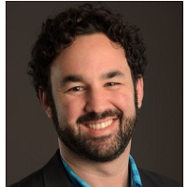
Jason Gerson,
PhD
Senior Program Officer for the Clinical Effectiveness and Decision Science program at the Patient-Centered Outcomes Research Institute (PCORI)
Provides intellectual and organizational leadership in designing and implementing new CER methods initiatives
Leads some of PCORI’s open science initiatives, including the development of a data sharing policy.
CIMPOD 2017 Opening Presentation: PCORI Support of Causal inference Research: A Match(ing Methods) Made in Heaven

Slide 11

John Seeger,
PharmD, DrPH
Pharmacoepidemiologist and Chief Scientific Officer at Optum Epidemiology
Conducted many studies that have addressed regulatory drug safety issues
Worked extensively with propensity scores
Teaches several courses on propensity scores in pharmacoepidemiology
CIMPOD Workshops: Propensity Score

Slide 12
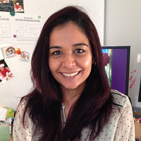
Kunjal Patel,
DSc, MPH
Senior Research Scientist, Harvard T.H. Chan School of Public Health
Research scientist for the Pediatric HIV/AIDS Cohort Study (PHACS) and the International Maternal Pediatric Adolescent AIDS Clinical Trials group (IMPAACT)
Extensive methodological expertise in the design and analysis of studies conducted using large observational cohorts
CIMPOD Workshops: IPW for Static Interventions

Slide 13
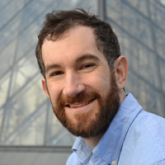
Michael Rosenblum, PhD
Associate Professor of Biostatistics at Johns Hopkins Bloomberg School of Public Health
Research focuses on causal inference and development of methods for the design and analysis of randomized trials.
Collaborates with clinical investigators in stroke, HIV prevention, cardiac resynchronization devices, and Alzheimer's disease prevention
CIMPOD 2017 Workshops: Doubly Robust Estimators focusing on TMLE

Slide 14
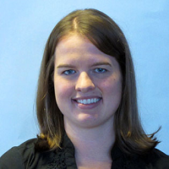
Sonja Swanson,
PhD
Assistant Professor in the Department of Epidemiology at Erasmus MC; adjunct affiliation with the Department of Epidemiology at the Harvard T. H. Chan School of Public Health
Methodological research focuses on improving the use and transparency of methods for estimating causal effects in epidemiology.
CIMPOD 2017 Workshops: IV Methods

Slide 15
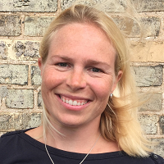
Lauren Cain,
PhD
Principal Statistician at Takeda Pharmaceuticals and a Visiting Scientist at Harvard T.H. Chan School of Public Health
Research interests include both the development and application of methods for causal inference from complex longitudinal data
Most recent work focuses on the optimal use of treatments through the comparison of dynamic treatment strategies.
CIMPOD 2017 Workshops: IPW for Dynamic Interventions

Slide 16
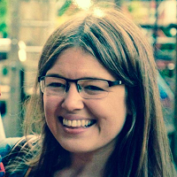
Rhian Daniel, MA MSc PhD
Assistant Professor in Biostatistics, London School of Hygiene and Tropical Medicine, Sir Henry Dale Fellow
Interested in statistical methods for mediation analysis, time-dependent confounding and other aspects of causal inference
Passionate about teaching and disseminating these topics to a wider audience
CIMPOD 2017 workshops: Counterfactual-based Mediation Analysis

Slide 17
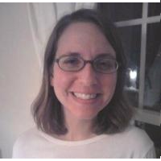
Jessica Young,
PhD
Assistant Professor and Biostatistician in the Department of Population Medicine, Harvard Medical School and the Harvard Pilgrim Health Care Institute
Research focuses on the theoretical development and application of causal inference methods
Also focuses on increasing applied researchers' access to these methods and ideas through education and software
CIMPOD 2017 Workshops: Use of Parametric G-formula

Slide 18
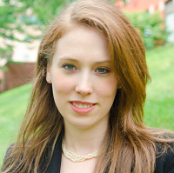
Sherri Rose,
PhD
Associate Professor in the Department of Health Care Policy at Harvard Medical School
Research centered around developing and integrating innovative statistical approaches to advance public health and health care research
Methodological research focuses on nonparametric machine learning for causal inference and prediction
Coauthored the book "Targeted Learning: Causal Inference for Observational and Experimental Data” by Springer Series in Statistics.
CIMPOD 2017 Workshops: Machine Learning

Slide 19
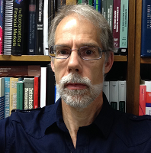
David Drukker,
PhD
Executive Director of Econometrics at Stata
Developed many Stata commands for estimating treatment effects
Played a key role in the initial development of Stata MP
Helped integrate Mata into Stata and develop some of Stata & numerical techniques
Published on econometric methods and been principal investigator on two large research grants
Current research interests are causal inference and spatial econometrics
CIMPOD 2017 Workshop: Estimating Treatment Effects in Stata

Slide 20
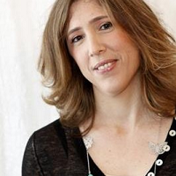
Michal Rosen-Zvi, PhD
Director for Health Informatics at IBM Research. She is also heading the Health Informatics Department at IBM Research, Haifa
Contributed to and led a number of multidisciplinary projects where physicians, data scientists and experts from Pharmaceutical companies joined forces to analyze post launch patients data.
Published close to forty peer-reviewed papers and co-chaired a dozen of workshops in the area of machine learning and health informatics
CIMPOD 2017 Workshop: Observational data: Shifting the paradigm from RCTs to retrospective studies
Workshop: Paradigm shift

Slide 21
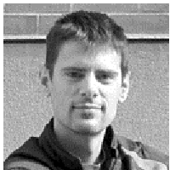
Miguel Hernán,
MD, ScM, DrPH
Professor of Department of Epidemiology and Department of Biostatistics, Harvard T.H. Chan School of Public Health
Help organized both CIMPOD 2016 and 2017
Conducts research on how to do research
Develop and apply causal inference methods to guide policy and clinical interventions
Investigates the optimal way to treat and prevent HIV infection, cancer, and cardiovascular disease
Author of upcoming textbook "Causal Inference" (Chapman & Hall/CRC, 2013), drafts of selected chapters are available on his website
CIMPOD 2017 Keynote Closing Address: Putting It All Together

Slide 22
Conference Agenda

Slide 23
Day 1 Morning
9:00-9:05 Conference Introduction - Yi Zhang
9:05-9:10 Welcoming Remarks - Greg Germino
9:10-9:30 PCORI Support of Causal Inference Research: A
Match(ing Methods) Made in Heaven - Jason Gerson
9:30am-12:30pm
1A. PS - John Seeger
A propensity score-matched cohort study of the effect of statins …
1B. IPW for Static Interventions - Kunjal Patel
Long-term effectiveness of highly active antiretroviral therapy on …
1C. Doubly Robust Estimators, TMLE - Michael Rosenblum
The risk of virologic failure decreases with duration of HIV …
1D. Instrumental Variable (IV) Methods - Sonja Swanson
Bounding the per-protocol effect in randomized trials: an…

Slide 24
Day 1 Afternoon
1:30pm-4:30pm
1E. IPW for Dynamic Interventions - Lauren Cain
When to start treatment? A systematic approach …
1F. Counterfactual-based Mediation Analysis - Rhian Daniel How much do tumor stage and treatment explain SES …
1G. Use of the Parametric G-formula to Estimate the Effects of Time-varying Treatments - Jessica Young
Changes in fish consumption in midlife and the risk of…
1H. Machine Learning - Sherri Rose
Mortality risk score prediction in an elderly population using ..
1I. Estimating Treatment Effects in Stata - David Drukker

Slide 25
Day 2 Morning
9:00am-12:00pm
2A. PS - John Seeger
A propensity score-matched cohort study of the effect of statins…
2B. IPW for Static Interventions - Kunjal Patel
Atazanavir exposure in utero and neurodevelopment in infants
2C. Doubly Robust Estimators with Focus on TMLE - Michael Rosenblum Safety and efficacy of minimally invasive surgery …
2D. Instrumental Variable (IV) Methods - Sonja Swanson
Methodological considerations in assessing the effectiveness of …
2I. Observational Data: Shifting the Paradigm from RCTs to Retrospective Studies - Michal Rosen-Zvi

Slide 26
Day 2 Afternoon
1:00pm-4:00pm
2E. IPW for Dynamic Interventions - Lauren Cain
When to monitor CD4 cell count and HIV RNA to reduce …
2F. Counterfactual-based Mediation Analysis - Rhian Daniel
How much do tumor stage and treatment explain SES …
2G. Use of the Parametric G-formula - Jessica Young
Comparative effectiveness of dynamic treatment regimes: an …
2H. Machine Learning - Sherri Rose
A Machine Learning Framework for Plan Payment Risk Adjustment
4:00pm-4:30pm
Closing Keynote Address: Putting It All Together - Miguel Hernán

Slide 27
Breakfast, coffee, and lunch breaks
Breakfast: 8-9am both days
Coffee/cookie break: 15 min for all workshops
Day 1 Lunch: 12:30-1:30pm
  Grab your lunch box if you pre-ordered from Fresh Fork
  Or go to cafeteria to buy lunch
  Use the round tables for lunch
Day 2 lunch: 1-2pm
Day 1 Wine & Cheese Reception: 4:30-7:00pm

Slide 28
Room Assignment
(Signs posted in hallways)
Room A: Workshops1A, 2A, 1F, 2F
Room C: Workshops 1B, 2B, 1E, 2E
Room D: Workshops 1C, 2C, 1H, 2H
Room E1/E2: Workshops 1D, 2D, 1G, 2G, 1I, 2I
Room G: Speakers’ room

Slide 29
Two New CER Tools funded by PCORI

Slide 30
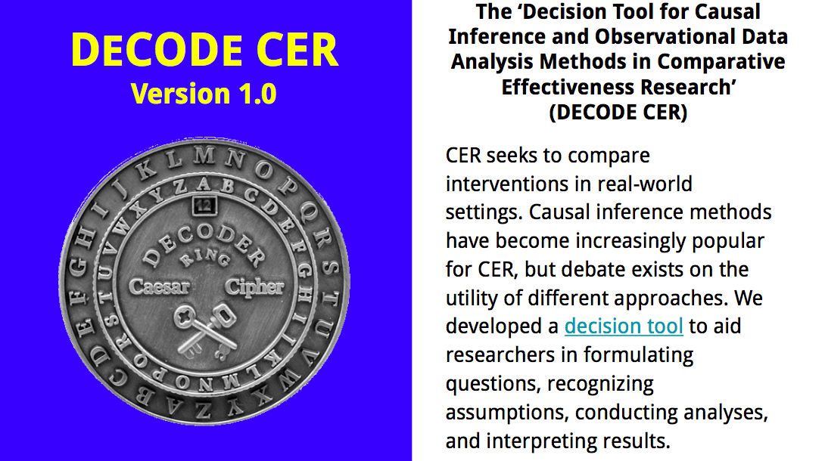
Please contact Douglas Landsittel, PhD, at douglandsittel@pitt.edu for more information.

Slide 31

CERBOT.ORG
Announcing the Feb. 2017 Release of CERBOT.ORG
  A New Web-based Tool for CER
This tool will help you design your CER study using causal inference statistical methods. By navigating the five modules found in CERBOT, you will 'emulate' a randomized clinical trial using your observational data source.
Sign up to be a beta-tester of the tool

Slide 32
Conference Evaluation
Before leaving the conference, please take a couple minutes to provide us feedback
Let us know your ideas on advancing causal inference

Slide 33
That’s it for now! Hope to see you at the Wine & Cheese Reception!

